Slide 1
WSB Monitoring
By Acme Labs (3/26/14)

Slide 2
Agenda
The Team
Background
High Level Architectural Diagrams
WSB Monitoring
Overview
Kibana/Logstash/Elastic Dashboard
Admin Page
The Future
Questions/Feedback

Slide 3
The Team
Engineers:
Jared Lera
Kevin Zhang
Ashish Shubham
Manoj Pahuja
Angela Simpson
Program Manager: Fleurette Houser
Development Manager: Lak Palaniappan

Slide 4
Background
Problem statement: problems aren’t detected until customers experience them first.
PRE-MONITORING
Note: developers are made aware of the problems a possible couple days after customers experience them.
POST-MONITORING
Note: customers may not necessarily experience the problems at all.
Customers experiencing issues
Inbound C3 calls
C3 escalates to ATS
ATS escalates to Devs
Devs fixing issues
Monitoring dashboard displays/sends alert
Appropriate team gets notified
Team fixing issues
PRO-ACTIVE

Slide 5
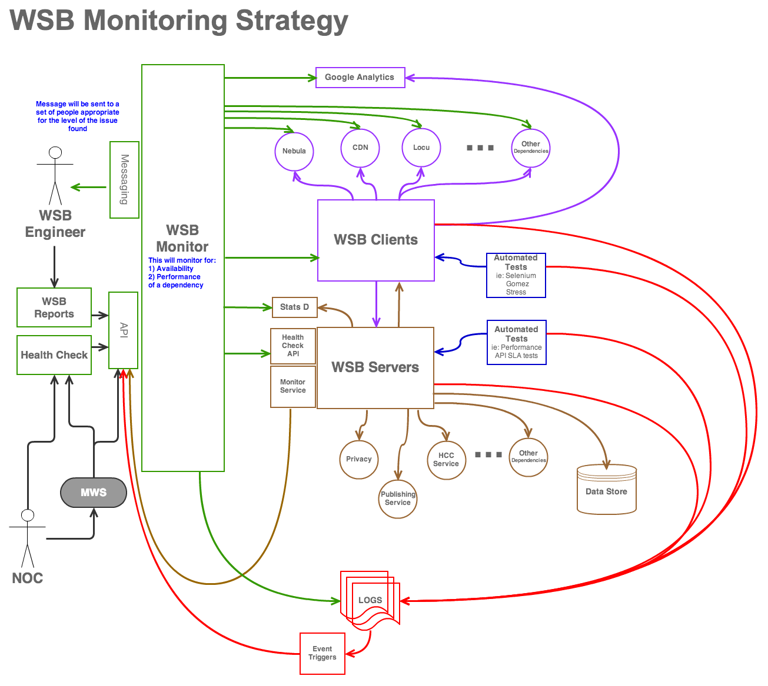
High Level Architectural Diagram

Slide 6
WSB Monitoring
Overview
Dashboard showing 4 possible health statuses:
Critical (red)
Warning (yellow)
Error (orange)
Informational (green)
Currently integrated applications:
DPS
WSB
WSB API
Locu

Slide 7
WSB Monitoring (cont’d)
Kibana/Logstash/Elastic Dashboard
Displays health indexes of multiple apps
Monitors the client-side servers
Self-Managed/Configurable Admin Page:
Threshold values management
Add/update/delete dependencies
Alerts management

Slide 8
The Future
To have WSB monitoring system as a corporate monitoring system, which means incorporating the system with other internal GoDaddy teams.

Slide 9

Questions/Feedback

